Slide 1
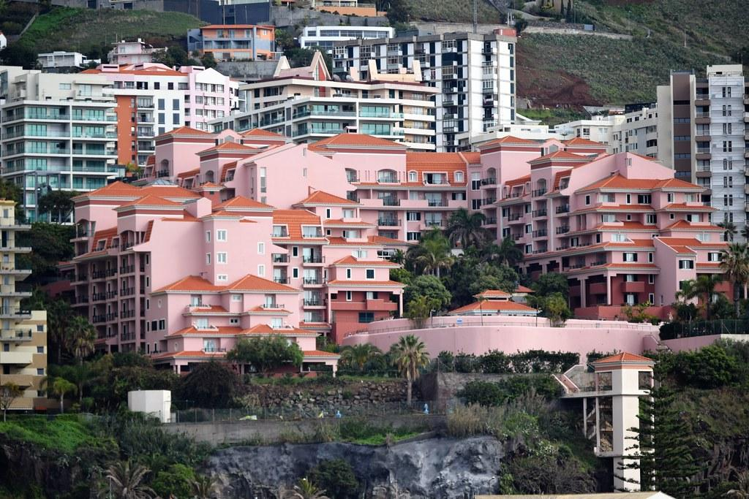
The Pink Palace

Slide 2
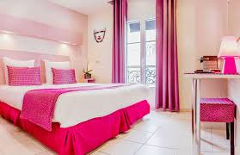
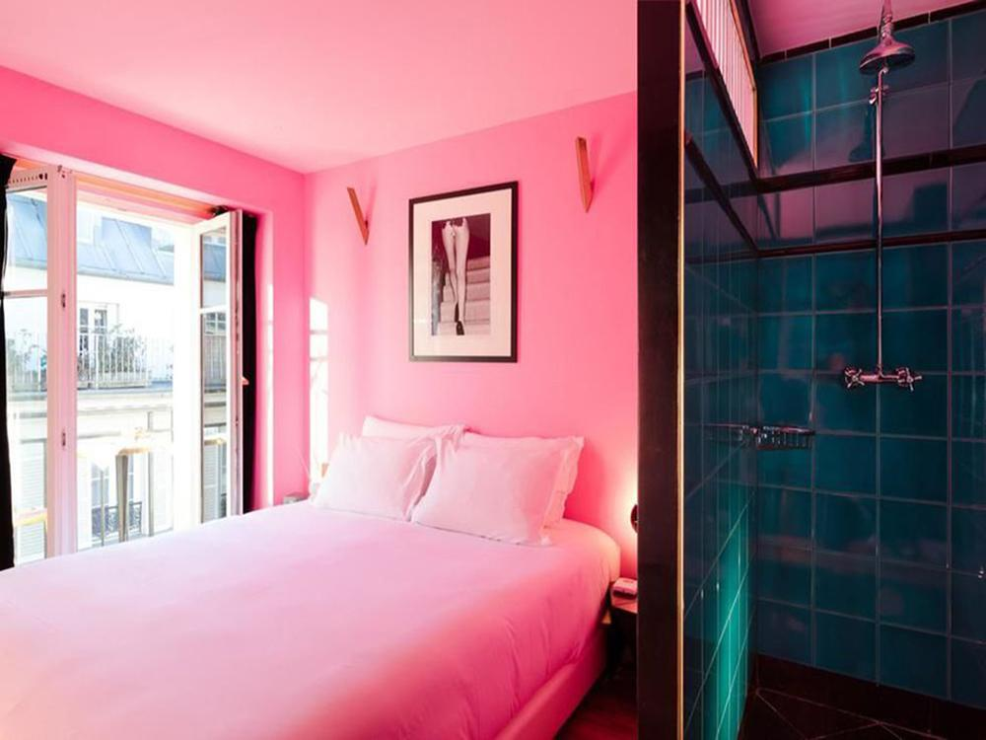
Location - Los Angeles, California - near Santa Monica Beach
Warm, all year round
Largely populated city

Slide 3
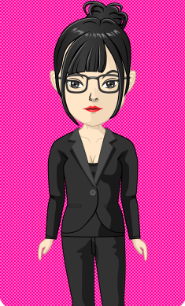
Traveling Business Women
Demographics | Pyschographics | Geographic | Behavioral
Gender - Female | Independent | Europe | Plans trip as soon as business event is scheduled
Age Range - 20’s - 35 | Hard Working | Asia | Desires Luxury - Willing to spend extra for better service/room care
Occupation - Business/any traveling job | Wants time to relax by self | Come from more urban/populated areas | Comes back everytime in the LA area

Slide 4
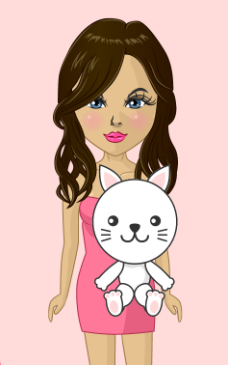
Influencers/Celebrities
Demographics | Pyschographics | Geographic | Behavioral
Age Range - 16-28 | Want to be famous/well known | Largely Populated Cities | Books and travels in summer/warmer months
Single Female | Values Fashion and Style | Western United States | Wants luxury feel at a midrange price
Single | Likes Nightlife | Hot weather/ temperatures | Willing to splurge for better/cuter rooms

Slide 5
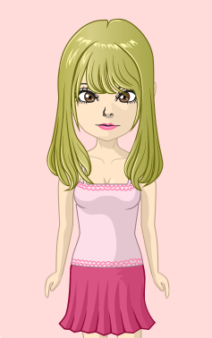
Young adults/college students on vacation
Demographics | Pyschographics | Geographics | Behavioral
Age Range - 17-26 | Wants to have a fun vacation with friends | Urban cities/ largely populated areas | Books 6-12 months in advance
Gender - Female | Quality time with friends | Western United States | Books in summer months because no school
Education - Graduating Highschool/ in college | Fun, party girl personality | Anywhere in United States (they are on vacation) | Cheaper rooms

Slide 6
Activities - things to do
Great places to take pictures for influencers and others on vacation
Pink bus that acts as a taxi and a ride to the beach every hour for your convenience
Room service and personal assistance available at all times for traveling business women
Pool to relax in with poolside bar with lots of pink drinks
Beach nearby with activities such as surfing, swimming with stingrays, and snorkeling provided by The Pink Palace

Slide 7
Final Questions
She did not answer this, so she lost points

